Slide 1

Chapter 6
Teachers Discovering Computers
The Changing Face of Education – Teaching Online

Slide 2
Chapter Objectives
Describe online learning and virtual environments
Describe how online and mobile technologies are changing the ways we teach and learn
Explain the differences between 100 percent online and blended learning
Explain the skills and strategies you need to know as an online teacher
List characteristics of a virtual school
Explain how apps, Web pages, blogs, wikis, and screencasts can be used as tools to enhance teaching and learning
Distinguish instructional strategies for differentiated online learning experiences
Identify online assessment or eAssessment techniques

Slide 3
Distance Education
Distance education, also called distance learning, and distributed learning, is defined as the delivery of instruction from one location to another
A Web-based course (also called an online course or eLearning course) is a course delivered via the Web
Online education may be:
  Synchronous
  Asynchronous
  Instructor-led
  Self-paced
  Combination

Slide 4
Distance Education
The delivery of distance learning courses can take on different forms
  Web-based training
  Online tutorials
  Online workshops
  Web conferencing
  Webinar
  Webcast

Slide 5
Distance Education
Today, all
  federal and state governments,
  most local governments,
  as well as many businesses and organizations
provide employees with some type of Web-based training in order to teach new skills or upgrade current skills
Thousands of online classes are available in virtually all disciplines and millions of undergraduate and graduate students take online classes every term

Slide 6
Distance Education
States and school districts are adopting online training as a way to train their teachers in many areas
A number of school districts and most states have developed online portals for their teachers to
  enroll in professional development courses
  access resources
  and receive assistance
Many companies and universities now work with school districts to provide graduate courses and online professional development training for teachers and administrators

Slide 7
The K-12 eLearning Environment
eLearning, also referred to as
  electronic learning
  online learning
  distributed learning
  virtual learning
  distance learning
utilizes a local network or the Internet for delivery of content and interaction between students and teachers
Classes take place in a virtual classroom environment or virtual learning environment

Slide 8
Growth of Online Schools and Programs
Many schools and universities use terms such as
  eLearning
  Online
  virtual
to define classes that are delivered completely online
Terms like
  Blended
  Hybrid
  mixed mode
Are used to define classes that are a combination of both F2F and online

Slide 9
Growth of Online Schools and Programs
A 100 percent online course, also called a Web-based course or virtual course, is a course or class taught completely on the Web
Brick-and-mortar school refers to a traditional school with physical buildings for teachers and students to gather

Slide 10
Growth of Online Schools and Programs
Research revealed that in 2011
  over 500,000 K-12 students attended some type of virtual school or online charter school full-time
  and three million additional K-12 students were enrolled in some type of education offered online

Slide 11
Growth of Online Schools and Programs
A virtual school, also called a;
  virtual charter school
  cyber school
  cyber charter school
refers to an institution not bound by brick-and-mortar buildings
Like F2F teachers, virtual teachers
  coordinate daily lessons
  interact with the students
  teach core content

Slide 12
Growth of Online Schools and Programs
Most virtual schools are very flexible in how they address students’ learning needs and schedules but their content is still standards-based and performance-driven
Virtual schools and brick-and-mortar schools hold the same high standards

Slide 13
Growth of Online Schools and Programs
A Learning Management System (LMS), also called Content Management System (CMS), is a
  Secure
  Restricted
  Internet-based
comprehensive package that includes
  instructional tools for school administrators
  documentation
  student tracking
  online courses
  classes content
  training content

Slide 14
Growth of Online Schools and Programs
Virtual school programs are created by school districts or commercial eLearning companies and are school programs that contain an online component
Parents who homeschool their children have the option of purchasing the curriculum they use to homeschool their children in an online format from an eLearning company

Slide 15
Growth of Online Schools and Programs
A learning coach is a teacher or instructor who
  creates individualized lessons
  engages with the learner through effective personal
    Communication
    Feedback
    and assessment
    as well as provides support and encouragement

Slide 16
Growth of Online Schools and Programs
Some high school virtual school programs have developed joint relationships with colleges and universities so their students can do dual enrollment
A Credit Recovery program provides a student with a way to regain credit toward graduation for a course that the student was previously unsuccessful in earning academic credit
Blended learning, also called hybrid learning or mixed mode learning, combines traditional classroom-based (F2F) courses with some type of eLearning instruction
The goal of a blended learning environment is to combine researched best practices with instructional techniques of both traditional F2F and online instruction

Slide 17
Growth of Online Schools and Programs
Differentiated instruction, also referred to as differentiated learning, involves providing students with different opportunities and ways to master content
A multitude of resources available on the Web can help you meet the often-demanding requirements of teaching virtually

Slide 18
Transitioning to Teaching Online
The daily tools you may use as an online teacher include
  course administration and/or learning management system (LMS)
  a word processor program
  a presentation program
  a calendar program
  an e-mail program
  a spreadsheet program
  different Web browsers
  your favorite Web 2.0 tools
  a screencast recording program
  plagiarism detection service

Slide 19
I Am Ready – Sign Me Up!
First, you should be well informed about the organization where you have applied to work
  Be familiar with the mission statement, history, and other information available that will help you understand whether the culture of the organization is aligned with your teaching and work philosophies
Before the interview, be sure to take an inventory of your greatest strengths and of your areas for improvement as a teacher, a leader, or a team member
One of the best ways to prepare for your new job is to ask questions

Slide 20
I Am Ready – Sign Me Up!
Develop the curriculum
Create supplemental materials
Compose letters welcoming students to your courses, reminding students of learning goals and deadlines, and giving feedback
Create a screencast
Use an online whiteboard, also known as an eLearning whiteboard

Slide 21
I Am Ready – Sign Me Up!
Really know the course content and assignments well beforehand
Test the learner experience
Teachers with in-depth content knowledge can find multiple ways to present the material
An established curriculum should have been developed to rigorous standards and include age, grade, and content appropriate questions
  You should present Bloom’s Taxonomy to students so they can understand and strive for higher levels of learning

Slide 22
I Am Ready – Sign Me Up!
Time management is the process you develop and tools you use to organize your day to be more efficient and productive
  Virtual office hours
When you establish your schedule, be sure to know the expectations of your school and district
Crafting a schedule that works takes time and, once created, your schedule will require constant adjustments
You will want to break down your day and create a daily to do list of what you need to do and what you want to accomplish

Slide 23
I Am Ready – Sign Me Up!
Team teaching is a method of instruction in which two or more teachers work together to combine their individual talents into one class or course
Whether you teach in a brick-and-mortar school, you teach online, or you teach a blended course, you should establish a home office

Slide 24
Tools for Online Learning
mLearning is a type of learning that incorporates the use of cost efficient, lightweight, portable devices such as smartphones or tablet computers
Today, there are over 50,000 apps that were created specifically for educational purposes, including thousands for K-12 teachers and students
A rapidly emerging trend is the use of curriculum-specific apps on mobile devices or mobile learning apps to supplement online teaching and learning, a concept called app-based learning or app-enhanced learning

Slide 25
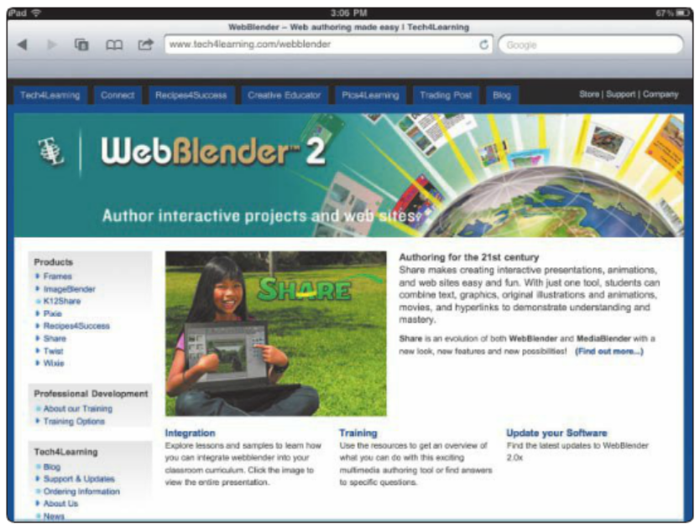
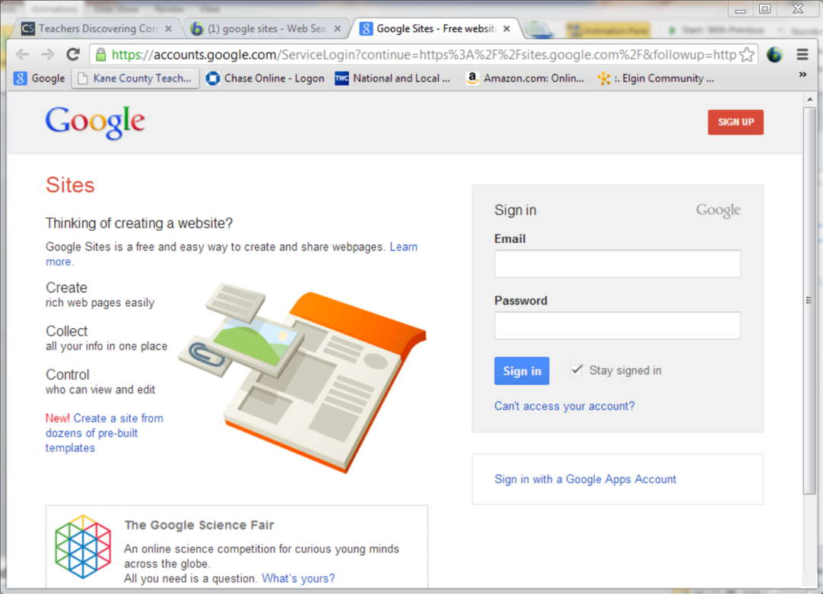
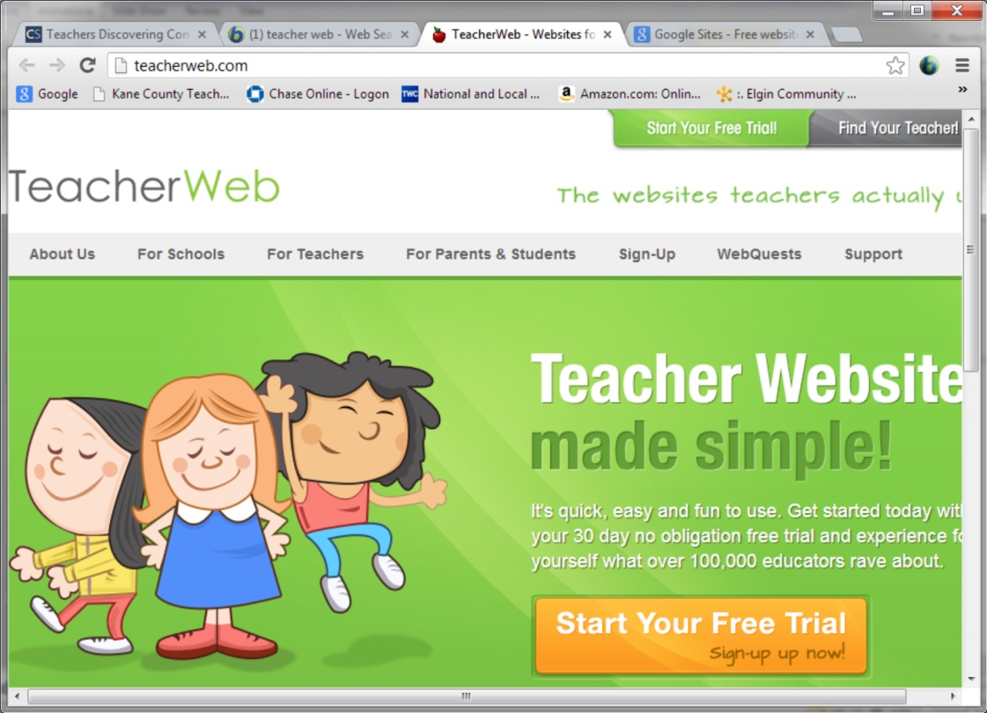
Tools for Online Learning
User-friendly Web development programs allow teachers, students, and other users to create their own Web resource pages using basic word processing skills
  Google Sites
  WebBlender 2
  iWeb
  TeacherWeb

Slide 26
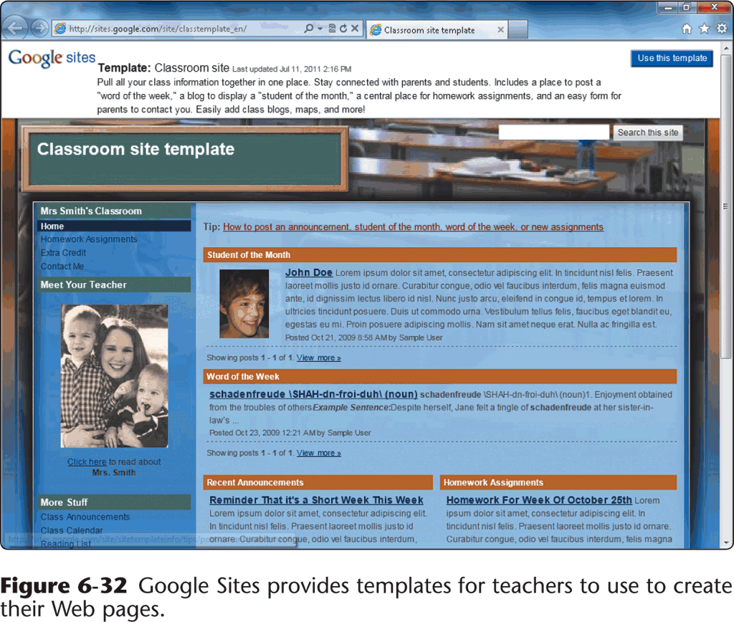
Tools for Online Learning
Students can use blogs to practice writing and communication skills
Teachers can use blogs to post daily or weekly assignments, generate thoughts, stimulate classroom discussion, connect with parents, and much more

Slide 27
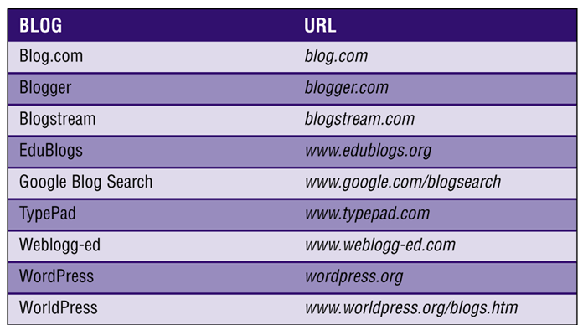
Tools for Online Learning

Slide 28
Tools for Online Learning
This ease of interaction and operation makes a wiki a great tool for group authoring — a powerful tool for use in teaching students team work, writing skills, and so much more
  Wikipedia
You can integrate wikis in virtually any curriculum
Wikis are great tools for journalism and collaborative writing
There are numerous Web sites that will walk you through creating a wiki and will even host your wiki for free

Slide 29
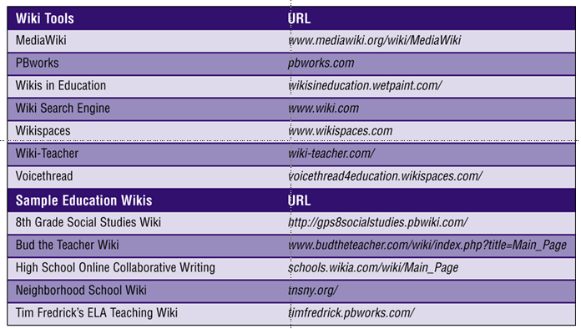
Tools for Online Learning

Slide 30
Tools for Online Learning
Podcasts are a popular way people share information on the Web using audio
A podcast is recorded audio stored in a file on a Web site
  Video podcast (vodcast)
The host or author of a podcast is often called a podcaster
A podcast can be downloaded to a computer or many mobile devices

Slide 31
Tools for Online Learning
To create a podcast, you need
  a computer with a microphone to capture the audio input
  software that allows you to export the audio file in the MP3 file format
  software that lets you create an RSS feed
  a site to upload your podcast to

Slide 32
Tools for Online Learning
Multimedia authoring software is used to create
  electronic presentations
  simulations
  and software demonstrations that can include
    text
    graphics
    video
    audio
    animation
    and screen captures
Camtasia Studio is a powerful, yet easy to use solution for you and your students to record, edit, and share high-quality instructional videos, student-created video-based projects, and more on the Web, via CDs, via DVDs, and via mobile devices, including tablets, smartphones, and iPods

Slide 33
Assessing Online Learning
Any instructional or supplemental materials should include an appraisal or assessment tool
A rubric is an explicit set of criteria that the student can use to self-evaluate his or her work prior to submission and that the teacher can use to provide feedback to the student
Alternative assessment uses nontraditional methods to determine whether students have mastered the appropriate content and skill level

Slide 34
Assessing Online Learning
Formative assessment is the evaluation of student learning based on a specific time span at multiple points by gathering various activities and assignments to make sure the learner is developing the knowledge, skills, and ability to master the content
Summative assessment is the process of evaluating the student learning at any given point in time

